Slide 1
Physical Layer
Transmission Media

Slide 2
Transmission Media
Transmission medium:: the physical path between transmitter and receiver.
Repeaters or amplifiers may be used to extend the length of the medium.
Communication of electromagnetic waves is guided or unguided.
  Guided media :: waves are guided along a physical path (e.g, twisted pair, coaxial cable and optical fiber).
  Unguided media:: means for transmitting but not guiding electromagnetic waves (e.g., the atmosphere and outer space).

Slide 3
Transmission Media Choices
Twisted pair
Coaxial cable
Optical fiber
Wireless communications

Slide 4
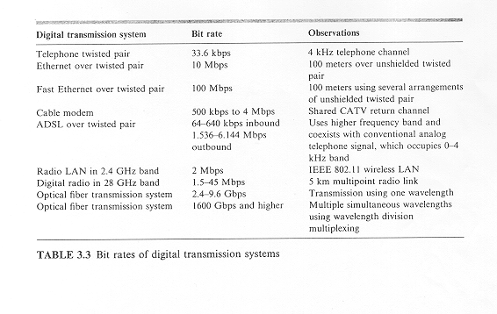
Digital Transmission Media Bit Rates

Slide 5
Twisted Pair
Two insulated wires arranged in a spiral pattern
Copper or steel coated with copper
The signal is transmitted through one wire and a ground reference is transmitted in the other wire.
Typically twisted pair is installed in building telephone wiring.
Local loop connection to central telephone exchange is twisted pair.

Slide 6
Twisted Pair
Limited in distance, bandwidth and data rate due to problems with attenuation, interference and noise
  Issue: cross-talk due to interference from other signals
  “shielding” wire (shielded twisted pair (STP)) with metallic braid or sheathing reduces interference.
  “twisting” reduces low-frequency interference and crosstalk.

Slide 7
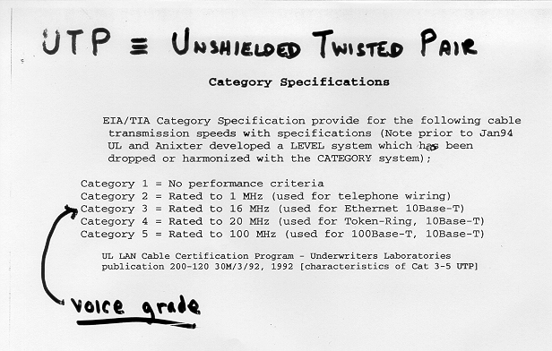
UTP (Unshielded Twisted Pair)
Category 3 corresponds to ordinary voice-grade twisted pair
found in abundance in most office buildings.
Category 5 (used for Fast Ethernet) is much more tightly
twisted.

Slide 8
Digital Subscriber Line (DSL) [LG&W p.137]
Telphone companies originally transmitted within the 0 to 4kHZ range to reduce crosstalk. Loading coils were added within the subscriber loop to provide a flatter transfer function to further improve voice transmission within the 3kHZ band while increasing attenuation at the higher frequencies.
ADSL (Asymmetric Digital Subscriber Line)
Uses existing twisted pair lines to provide higher bit rates that are possible with unloaded twisted pairs (i.e., no loading coils on subscriber loop.)

Slide 9
DSL
the network transmits downstream at speeds
ranging from 1.536 Mbps to 6.144Mbps
asymmetric
bidirectional
digital transmisssions
users transmit upstream at speeds ranging [higher frequencies] from 64 kbps to 640 kbps
0 to 4kHZ used for conventional analog telephone signals

Slide 10
DSL
ITU-T G992.1 ADSL standard uses Discrete Multitone (DMT) that divides the bandwidth into a large number of small subchannels.
A splitter is required to separate voice signals from the data signal.
The binary information is distributed among the subchannels. Each subchannel uses QAM.
DMT adapts to line conditions by avoiding subchannels with poor SNR.

Slide 11

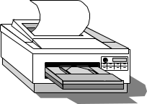

10BASE-T
10 Mbps baseband transmission over twisted pair.
Two Cat 3 cables, Manchester encoding,
Maximum distance - 100 meters
Ethernet hub
●     
Copyright ©2000 The McGraw Hill Companies
Leon-Garcia & Widjaja: Communication Networks
Figure 3.38

Slide 13
Coaxial Cable
Center
conductor
Dielectric
material
Braided
outer
conductor
Outer
cover
Copyright ©2000 The McGraw Hill Companies
Leon-Garcia & Widjaja: Communication Networks
Figure 3.39

Slide 14
Coaxial Cable
Discussion divided into two basic categories for coax used in LANs:
  50-ohm cable [baseband]
  75-ohm cable [broadband or single channel baseband]
In general, coax has better noise immunity for higher frequencies than twisted pair.
Coaxial cable provides much higher bandwidth than twisted pair.
However, cable is ‘bulky’.

Slide 15
Baseband Coax
50-ohm cable is used exclusively for digital transmissions
Uses Manchester encoding, geographical limit is a few kilometers.
10Base5 Thick Ethernet :: thick (10 mm) coax
10 Mbps, 500 m. max segment length, 100 devices/segment, awkward to handle and install.
10Base2 Thin Ethernet :: thin (5 mm) coax
10 Mbps, 185 m. max segment length, 30 devices/segment, easier to handle, uses T-shaped connectors.

Slide 16
Broadband Coax
75-ohm cable (CATV system standard)
Used for both analog and digital signaling.
Analog signaling – frequencies up to 500 MHZ are possible.
When FDM used, referred to as broadband.
For long-distance transmission of analog signals, amplifiers are needed every few kilometers.

Slide 17
Hybrid Fiber-Coaxial System
Upstream fiber
Fiber
Fiber
Head
end
Fiber
node
Fiber
node
Downstream fiber
Coaxial
distribution
plant
Bidirectional
Split-Band
Amplifier
Copyright ©2000 The McGraw Hill Companies
Leon-Garcia & Widjaja: Communication Networks
Figure 3.42

Slide 18
Optical Fiber
Optical fiber :: a thin flexible medium capable of conducting optical rays. Optical fiber consists of a very fine cylinder of glass (core) surrounded by concentric layers of glass (cladding).
a signal-encoded beam of light (a fluctuating beam) is transmitted by total internal reflection.
Total internal reflection occurs in the core because it has a higher optical density (index of refraction) than the cladding.
Attenuation in the fiber can be kept low by controlling the impurities in the glass.

Slide 19
Optical Fiber
(a) Geometry of optical fiber
light
cladding
jacket
core
(b) Reflection in optical fiber
θ_{c}
Copyright ©2000 The McGraw Hill Companies
Leon-Garcia & Widjaja: Communication Networks
Figure 3.44

Slide 20
Optical Fiber
Lowest signal losses are for ultrapure fused silica – but this is hard to manufacture.
Optical fiber acts as a wavelength guide for frequencies in the range 10 **14 to 10 **15 HZ which covers the visible and part of the infrared spectrum.
Three standard wavelengths : 850 nanometers (nm.), 1300 nm, 1500 nm.
First-generation optical fiber :: 850 nm, 10’s Mbps using LED (light-emitting diode) sources.
Second and third generation optical fiber :: 1300 and 1500 nm using ILD (injection laser diode) sources, gigabits/sec.

Slide 21
Optical Fiber
Attenuation loss is lower at higher wavelengths.
There are two types of detectors used at the receiving end to convert light into electrical energy (photo diodes):
  PIN detectors – less expensive, less sensitive
  APD detectors
ASK is commonly used to transmit digital data over optical fiber {referred to as intensity modulation}.

Slide 22
Optical Fiber
Three techniques:
  Multimode step-index
  Multimode graded-index
  Single-mode step-index
Presence of multiple paths ➔ differences in delay ➔ optical rays interfere with each other.
A narrow core can create a single direct path which yields higher speeds.
WDM (Wavelength Division Multiplexing) yields more available capacity.

Slide 23
(a) Multimode fiber: multiple rays follow different paths
reflected path
direct path
(b) Single mode: only direct path propagates in fiber
Copyright ©2000 The McGraw Hill Companies
Leon-Garcia & Widjaja: Communication Networks
Figure 3.46

Slide 25
Frequency (Hz)
10⁴
10⁵
10⁶
10⁷
10⁸
10⁹
10¹⁰
10¹¹
10¹²
FM radio & TV
Wireless cable
AM radio
Cellular
& PCS
satellite & terrestrial
microwave
LF
MF
HF
VHF
UHF
SHF
EHF
10⁴
10³
10²
10¹
1
10⁻¹
10⁻²
10⁻³
Wavelength (meters)
Copyright ©2000 The McGraw Hill Companies
Leon-Garcia & Widjaja: Communication Networks
Figure 3.48

